Slide 1



Kafka Cluster using docker compose

Slide 2
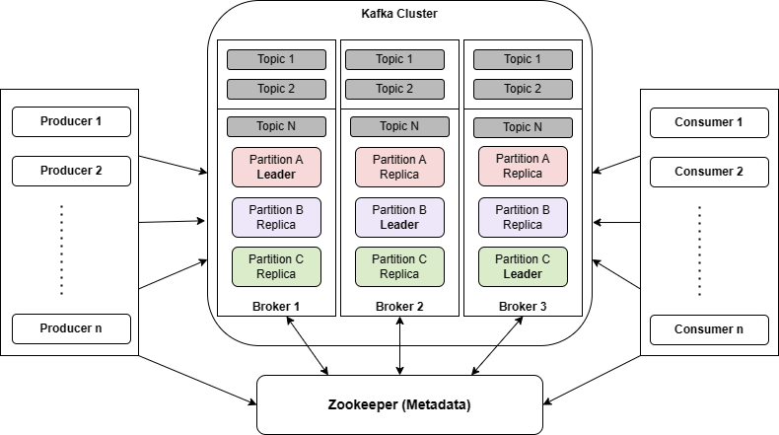
Use kraft mode instead

